Slide 1
PCR and Gel Electrophoresis
Skill Development and Pre-Lab Knowledge

Slide 2


PCR: What is it?
https://www.youtube.com/watch?v=a5jmdh9AnS4

Slide 3
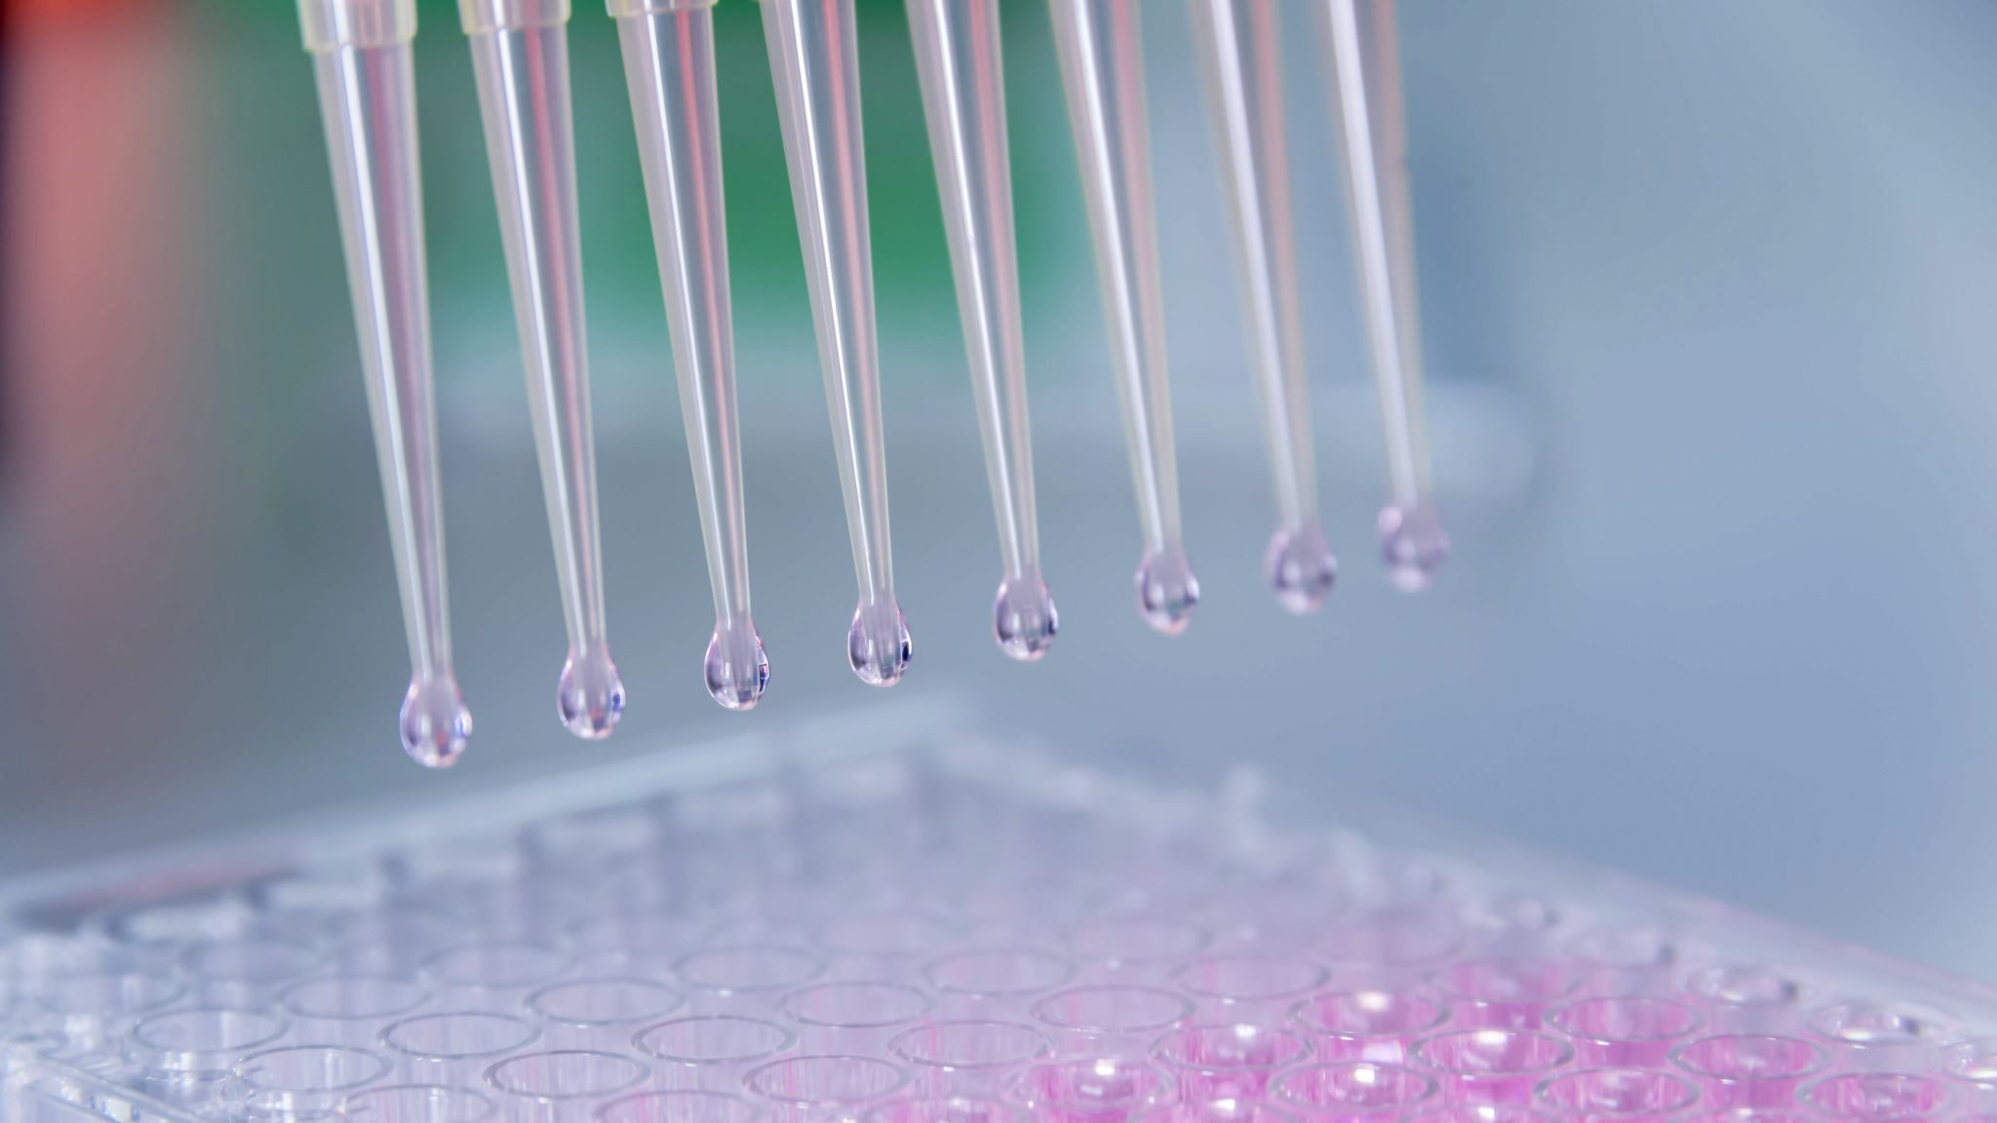

PCR in Summary
Denaturing at 94$°$C – breaks apart DNA strands
Annealing at 60$°$C – Allows primer to bind to certain parts of the sequence
Extension 72$°$C - DNA polymerase binds and DNA replication to start

Slide 4
Gel Electrophoresis
Your practical will be using Gel Electrophoresis to identify 2 random (out of 4 possible) unknown samples.
There will need to be 2 groups of 2 and 2 groups of 3 for the practical.
Equipment will include; 8 Eppendorf tubes with solutions (ladder sample, known samples and 2 unknowns), micropipettes, and gel electrophoresis machine.

Slide 5
Gel Electrophoresis: The process
We take the DNA master sample that was made during PCR and micropipette it into the wells of the gel
The agarose gel acts as a mesh wall for the DNA to move through.
When loading the DNA into the wells, be careful not to puncture the bottom or overflow the top- the wells act as a starting point for the DNA and if it is overflowed or leaking out the bottom the process won’t work.

Slide 6
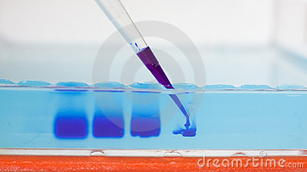

Slide 7
The Process
We then place the gel with the DNA down the negatively charged end and fill the contain with buffer to help produce the electrical current.
The Gel Electrophoresis machine is then turned on to allow the current to move through it- our current will be 100V and we leave it for 30mins.
The DNA will then move to through the gel to the positively charged side- separating depending on size.

Slide 8
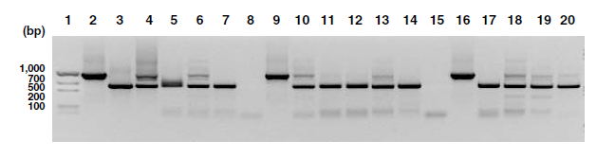
The Banding
The size of the DNA molecule will affect how far along the gel they can travel, separating into bands.
If we have a ladder present- which is a controlled known source of DNA (could be the pattern/ sequence for a certain hereditary disease or the sequence of suspect in a crime) we can compare our unknown source against the ladder and check for similarities.

